Slide 1

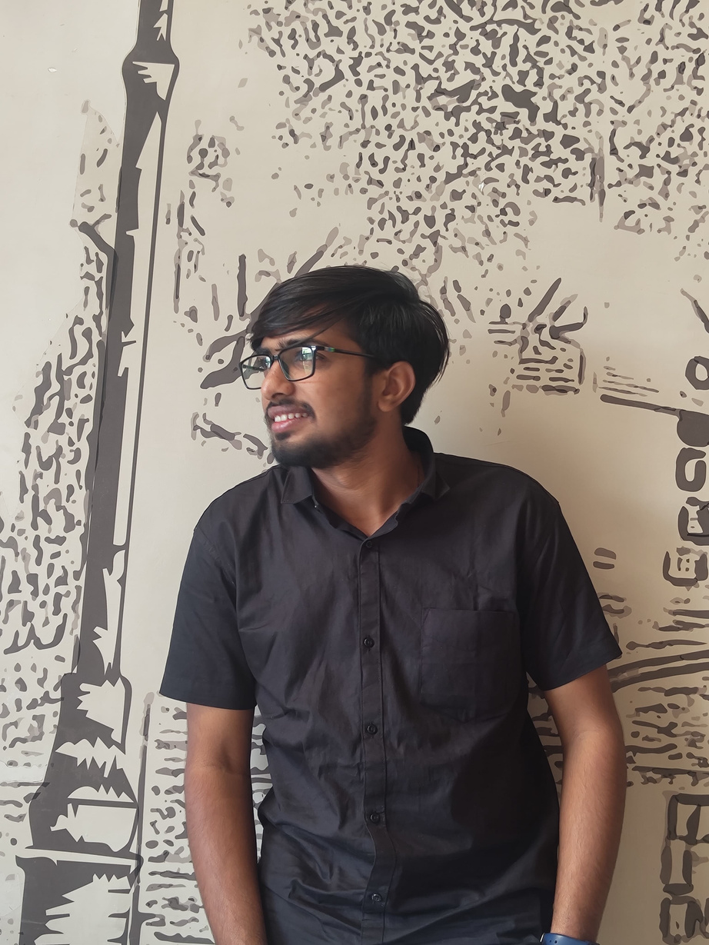
LET ME SHARE A LITTLE
ABOUT ME
KIRTAN BHIMANI
(NATIVE APPLICATION DEVELOPMENT)

Slide 2
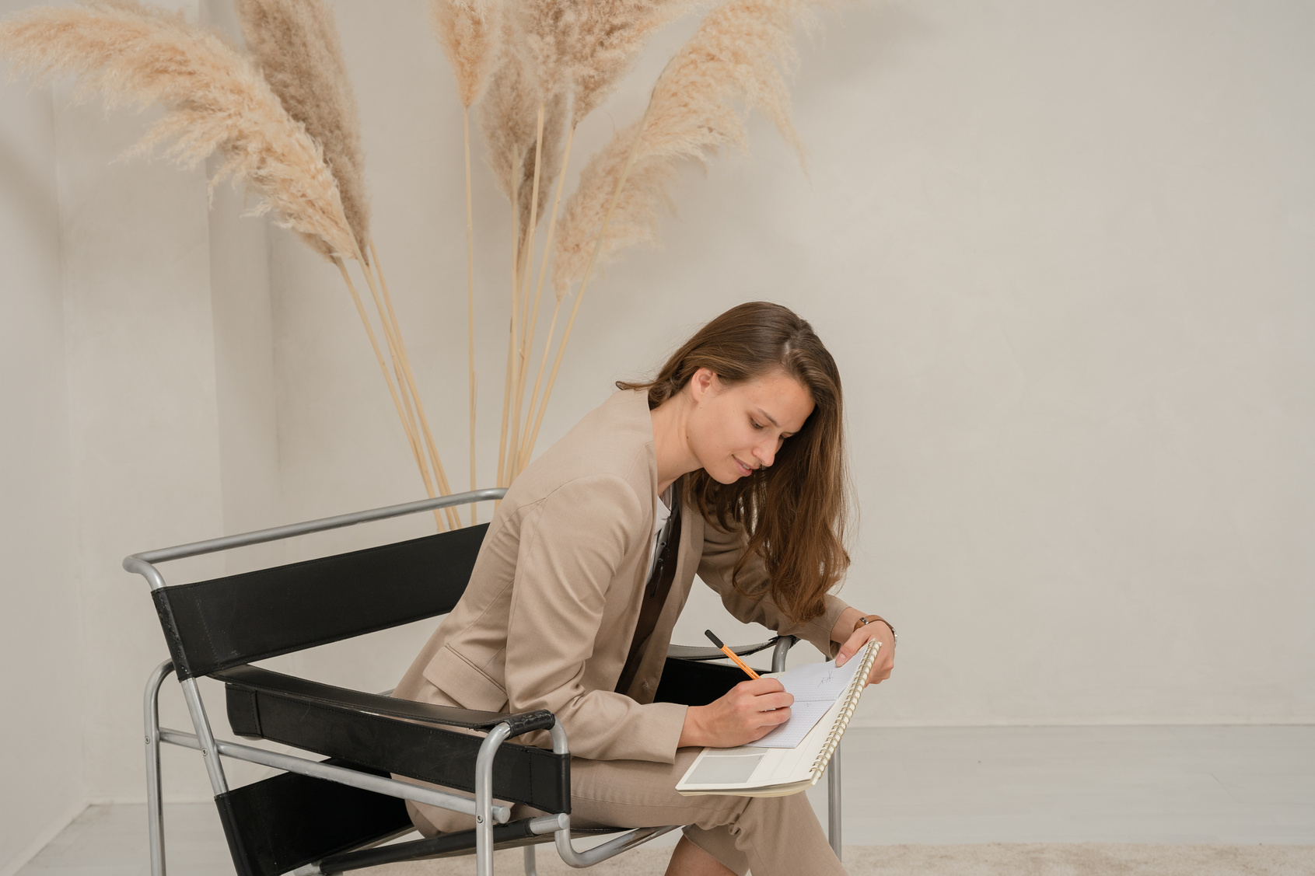
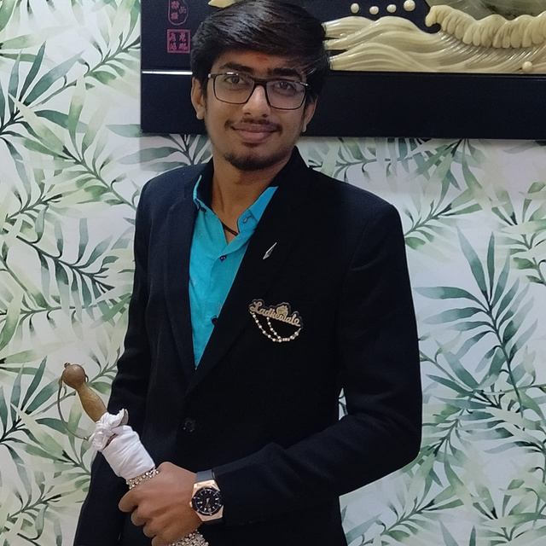
SOME OF MY KEY LIFE MOMENTS
Born in Amareli
2nd June 2003
Moved Cities in Surat
2005
Navchetan Vidhyabhavan Surat
SSC IN 2018
Alpha Vidhya Sankul Junagadh
HSC IN 2020
BE in Information Technology
2024
2024

Slide 3
I AM...
Creative...
Calm...
Positive Thinker...
Good Listener...
Strong...
Ambivert...
Quick Learner...

Slide 4
SWOT
S | W
Decision Making Keep Trying Hardworking | Use Mobile Can’t say NO Overthinking
O | T
Golden Opportunity to get place in IT industry. | My final year in college and fear of losing Friends.
S stands for Strength...
W stands for Weakness...
O stands for Opportunity...
T stands for Threat...

Slide 5

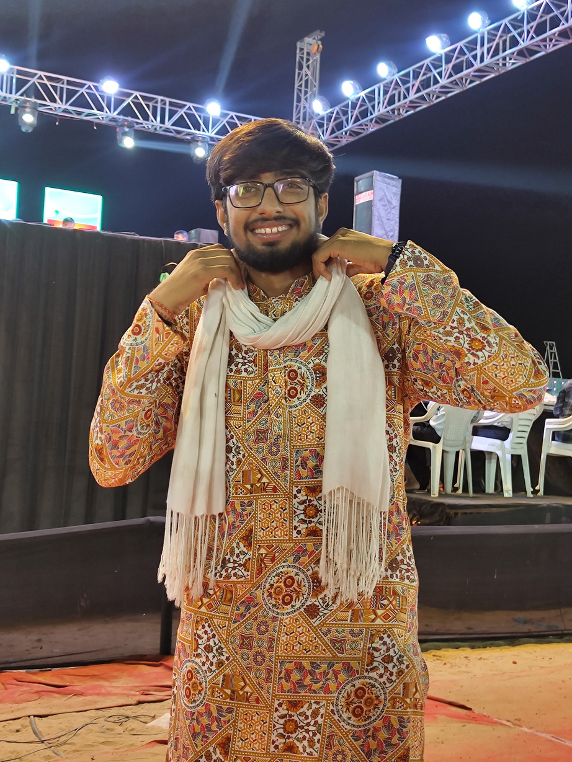

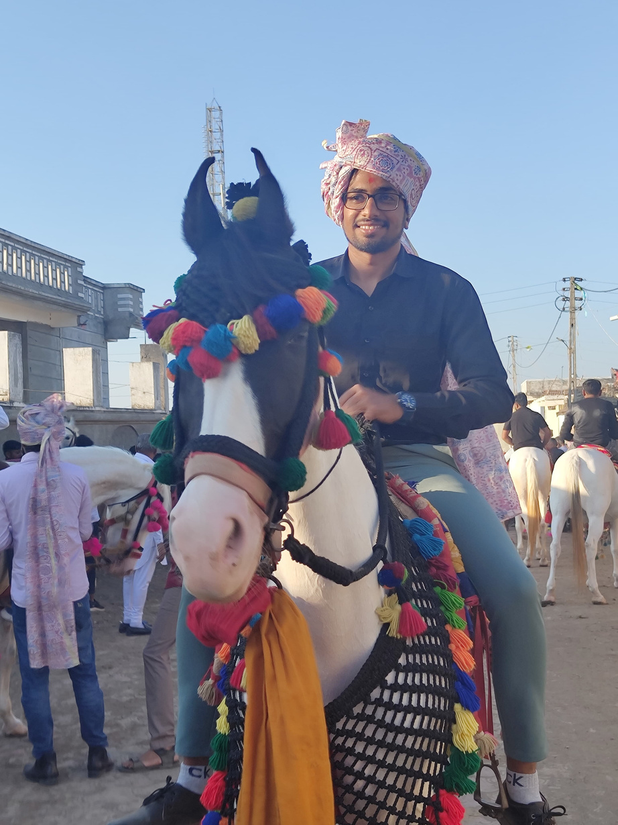
A FEW THINGS I REALLY LOVE
Playing Garba
Horse Riding
Tea
Being on time
Spending time with Friends
Baking with my family
Playing Cricket, Volleyball, Tennis
Reading History
Listening Music

Slide 6
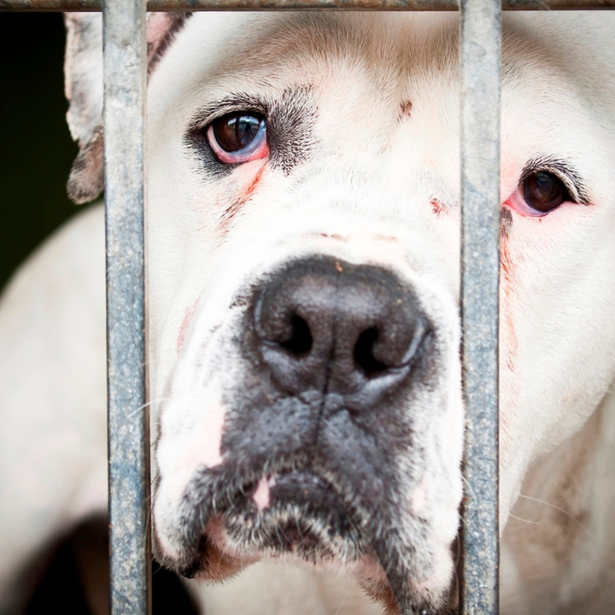
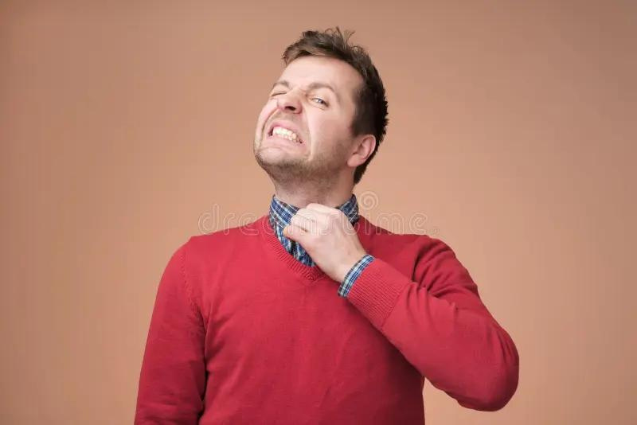
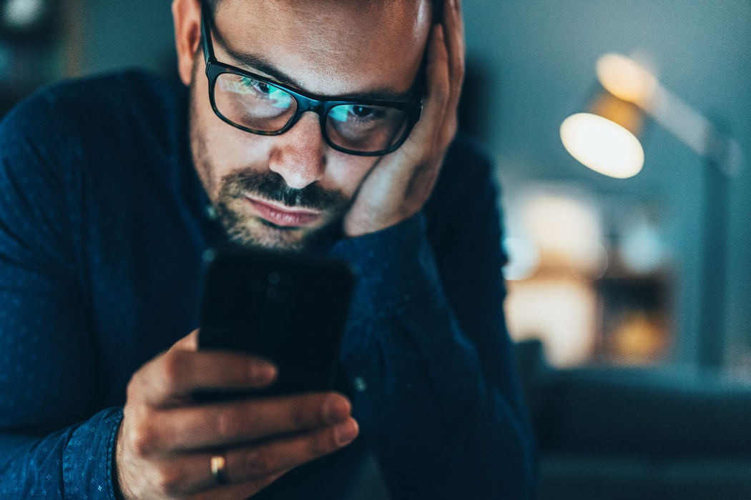

A FEW THINGS I REALLY HATE
Irritating people
Uncomfortable clothes
To much taking care
Attitude people
People who harassing Animals and Birds
Cheating people

Slide 7
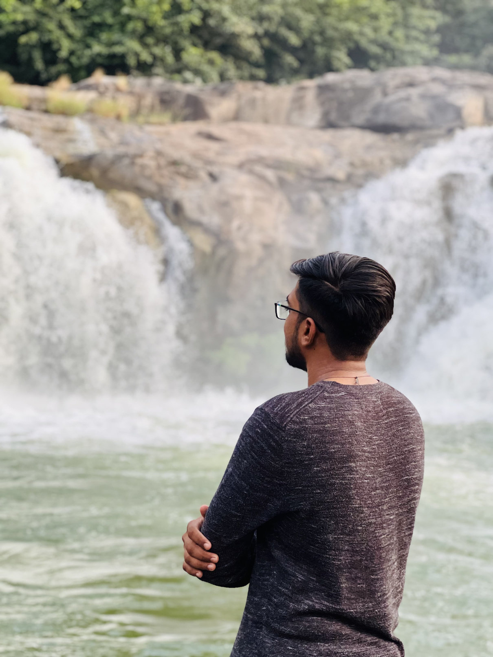
I strongly believe in
कर्मण्ये वाधिकारस्ते ;
मा फलेषु कदाचन ।
मा कर्म फलहेतुर्भूमा ते ; संगोऽस्त्वकर्मणि ।।
THANK YOU FOR GIVING YOUR TIME!

